Slide 1
LOI Info Session: 662 Hartford Ave
RI Department of Housing
November 30, 2022

Slide 2
Agenda
LOI Information Session: 662 Hartford Ave, Providence
Purpose
Background on property
Provider responsibilities
Insurance requirements
Timeline

Slide 3
Purpose
Repurposing 662 Hartford Ave into a temporary emergency winter shelter
The State is interested in expanding temporary emergency winter shelter capacity to accommodate the current and projected needs of persons experiencing chronic street homelessness. Therefore, the State, through its Office of Housing and Community Development (OHCD), is soliciting proposals to expand shelter capacity for up to 16 individuals at 662 Hartford Ave in Providence.

Slide 4
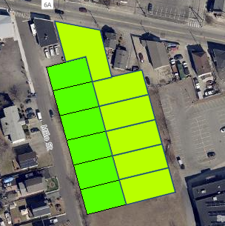
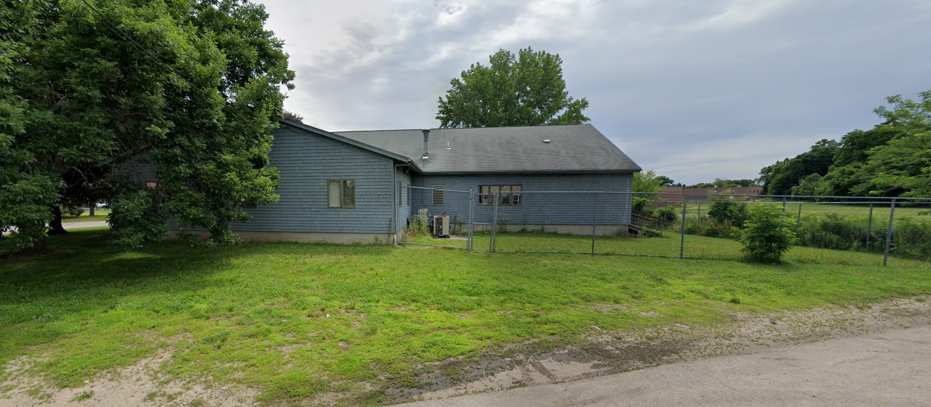
Background on Property
Property owned by Department of Behavioral Healthcare, Developmental Disabilities & Hospitals (BHDDH).
0.69 acres, 7,450 sq ft
Listed as group home, has green space connected to it
Group home building
Delsesto-Springfield Middle School
Open green space
Notes:
Flag: proximity to middle school, we will include language in service provider contract that the service provider must comply with state and federal regulations as it relates to admitting appropriate populations (i.e. – no sex offenders will be allowed at this shelter, due to close school proximity).

Slide 5
Background on Property (cont.)
662 Hartford Ave is a state-owned property, currently owned, but unused, by BHDDH. The property is located in a residential neighborhood in close proximity to a school.
The property requires minor repairs that OHCD will cover and work with DCAMM to repair.
Once the property is repaired and safe for habitation (aiming for end of December), OHCD proposes leasing the space to a current consolidated homeless fund vendor to operate an emergency winter shelter for up to 16 individuals (Provider) that will operate 24 hours/day.
The population is limited to 16 individuals due to fire code and safety.
Notes:
Flag: proximity to middle school, we will include language in service provider contract that the service provider must comply with state and federal regulations as it relates to admitting appropriate populations (i.e. – no sex offenders will be allowed at this shelter, due to close school proximity).

Slide 6
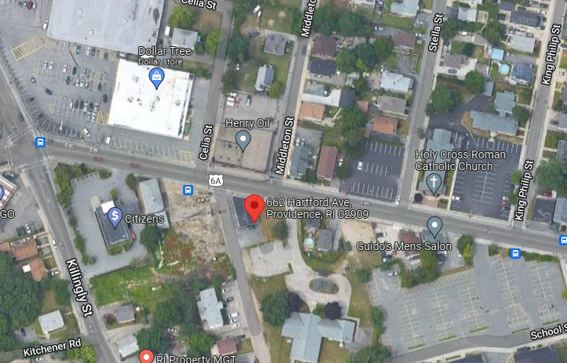
Background on Property (cont.)
Notes:
Flag: proximity to middle school, we will include language in service provider contract that the service provider must comply with state and federal regulations as it relates to admitting appropriate populations (i.e. – no sex offenders will be allowed at this shelter, due to close school proximity).

Slide 7
Provider Responsibilities
The Provider will be responsible for all costs associated with operating the shelter. Examples of eligible activities for operating the emergency winter shelter may include, but are not limited to the following:
Purchase of equipment, such as furniture or mobile air filters
Rent (Provider may assume that the rent is $1/month), utilities, maintenance, and security
Supplies and food for 3 meals a day for up to 16 individuals
Administration fee of no more than 5%
Transportation to and from new shelter site
Staffing
HMIS or comparable database license
Case management to support new clients at the shelter
Client supports (transportation, birth certificate fees, drug testing, etc.)
Notes:
Flag: proximity to middle school, we will include language in service provider contract that the service provider must comply with state and federal regulations as it relates to admitting appropriate populations (i.e. – no sex offenders will be allowed at this shelter, due to close school proximity).

Slide 8
Insurance Responsibilities
The following insurance coverage shall be required of the awarded Respondent(s):
General Liability up to $1,000,000 per occurrence
Workers’ Compensation up to $100,000 for each accident
Automobile Liability up to $1,000,000 for each occurrence
Professional services – working with children, elderly, or disabled persons (Only required if serving children, elderly, or disabled.
Notes:
Flag: proximity to middle school, we will include language in service provider contract that the service provider must comply with state and federal regulations as it relates to admitting appropriate populations (i.e. – no sex offenders will be allowed at this shelter, due to close school proximity).

Slide 9
Timeline
The deadline to submit Letters of Interest (hard copy or electronically) is 4:00pm on Wednesday, December 7, 2022.
The Department of Housing reserves the right to request additional information from applicants on submitted applications. Applicants are required to respond to questions within 2 business days.

Slide 10
Questions?

